Slide 1
DevOps Industrial Training

Slide 2

Ansible

Slide 3
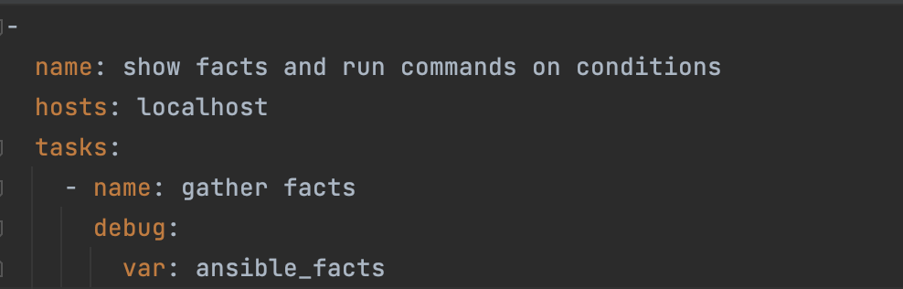
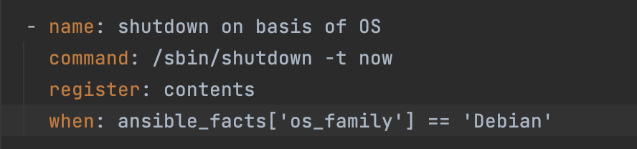
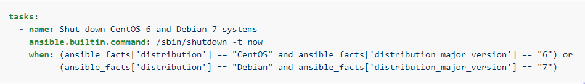
Ansible – Conditional
Often you want to execute or skip a task based on condition.
Facts are attributes of individual hosts, including IP address, operating system, the status of a filesystem, and many more.
With conditionals based on facts:
    You can install a certain package only when the operating system is a particular version.
    You can skip configuring a firewall on hosts with internal IP addresses.

Slide 4
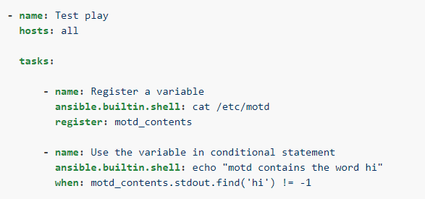
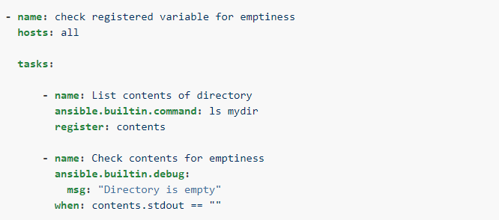
Conditions Based on Registered Variables
Often in a playbook you want to execute or skip a task based on the outcome of an earlier task.
For example, you might want to configure a service after it is upgraded by an earlier task.
To create a conditional based on a registered variable:
Register the outcome of the earlier task as a variable.
Create a conditional test based on the registered variable.

Slide 5
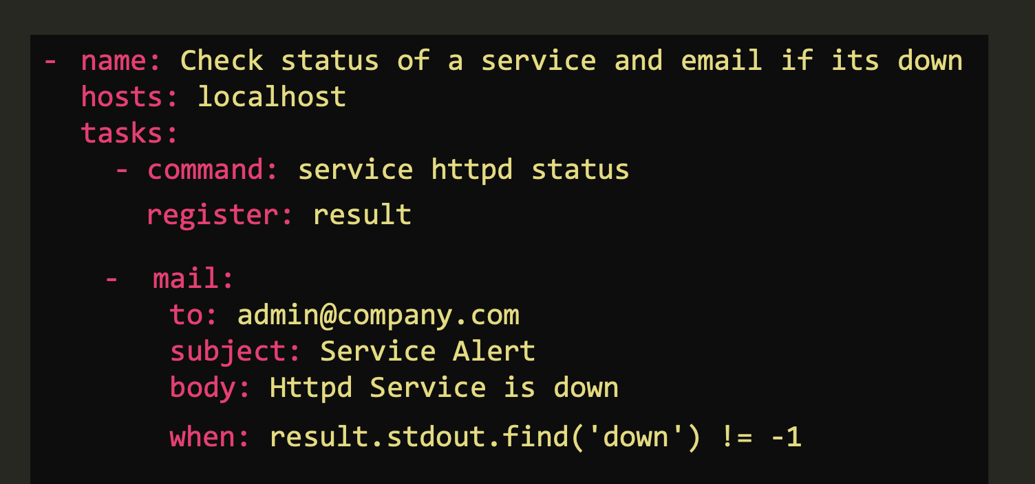
Conditions Based on Registered Variables
Send mail if service is shutdown

Slide 6
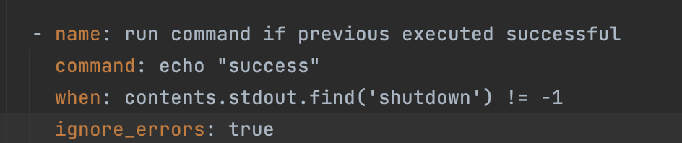
Error Handling
When Ansible receives a non-zero return code from a command or a failure from a module, by default it stops executing on that host and continues on other hosts.
However, in some circumstances you may want different behavior.
Sometimes a non-zero return code indicates success.
Sometimes you want a failure on one host to stop execution on all hosts.
Ansible provides tools and settings to handle these situations and help you get the behavior, output, and reporting you want.

Slide 7
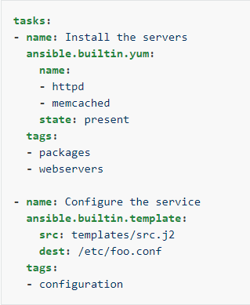
Tags
If you have a large playbook, it may be useful to run only specific parts of it instead of running the entire playbook.
You can do this with Ansible tags. Using tags to execute or skip selected tasks is a two-step process:
Add tags to your tasks, either individually or with tag inheritance from a block, play, role, or import.
Select or skip tags when you run your playbook.
If you ran these tasks in a playbook with --tags packages, Ansible would run the first task tagged package and skip the one task that does not have that tag.

Slide 8
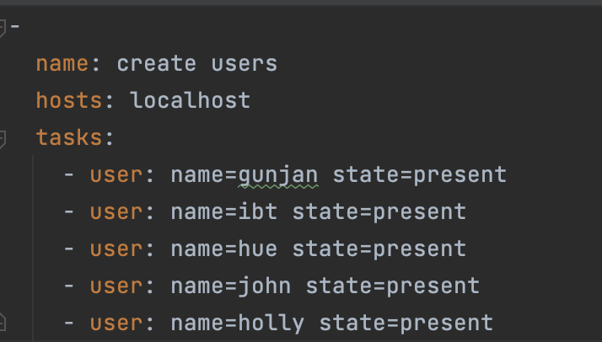
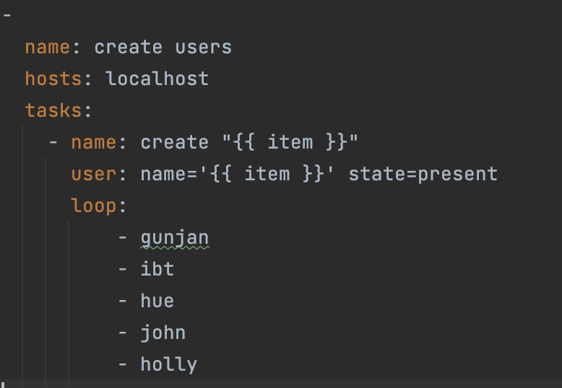
Loops
Sometimes we might want to install multiple packages at once, in such cases we can use loop

Slide 9
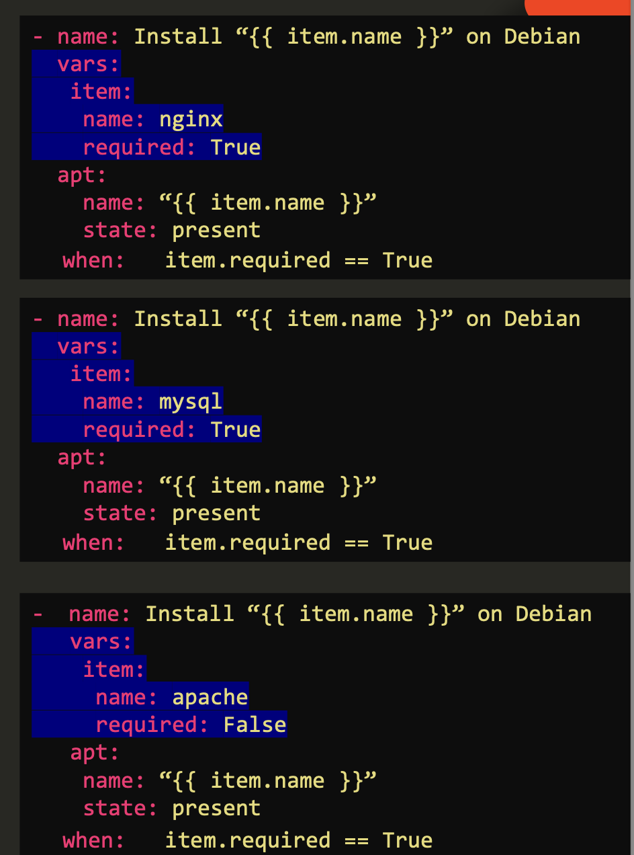
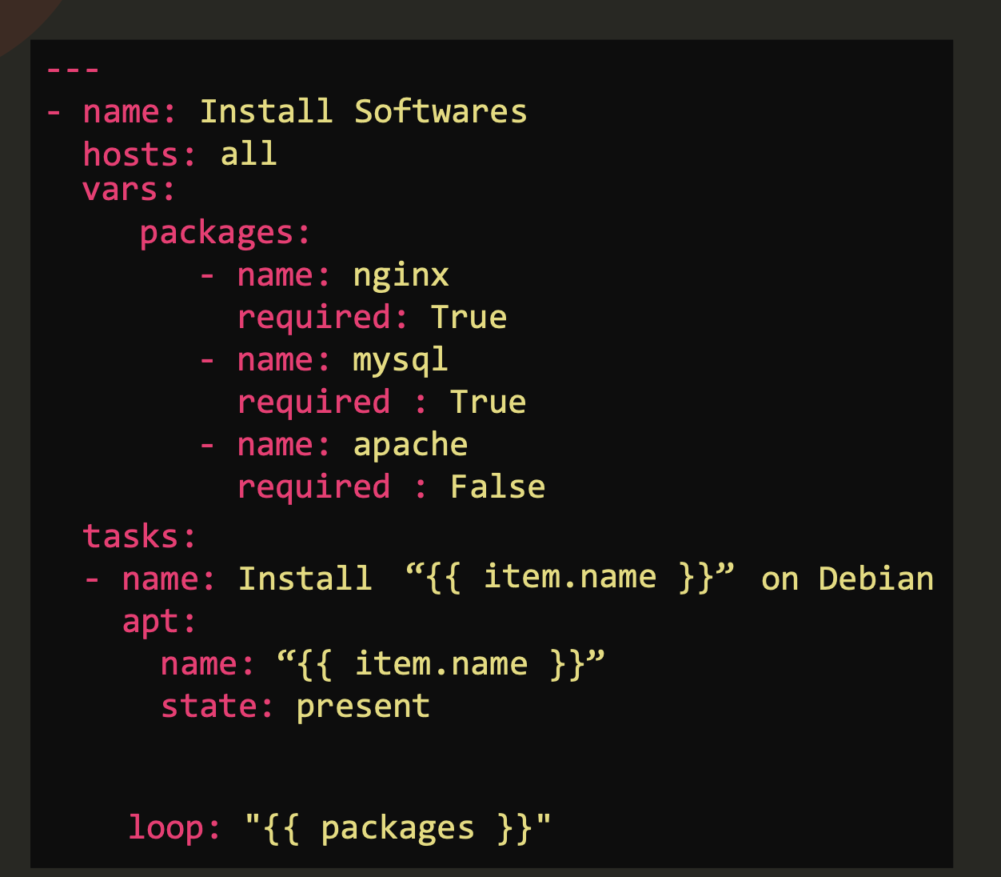
Loops

Slide 10
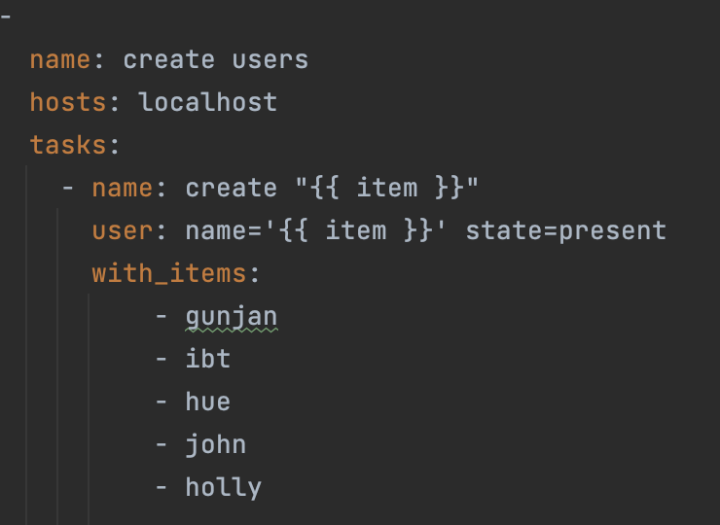
Loop vs with_*
Both Playbooks yield same results
Loop was added recently.

Slide 11
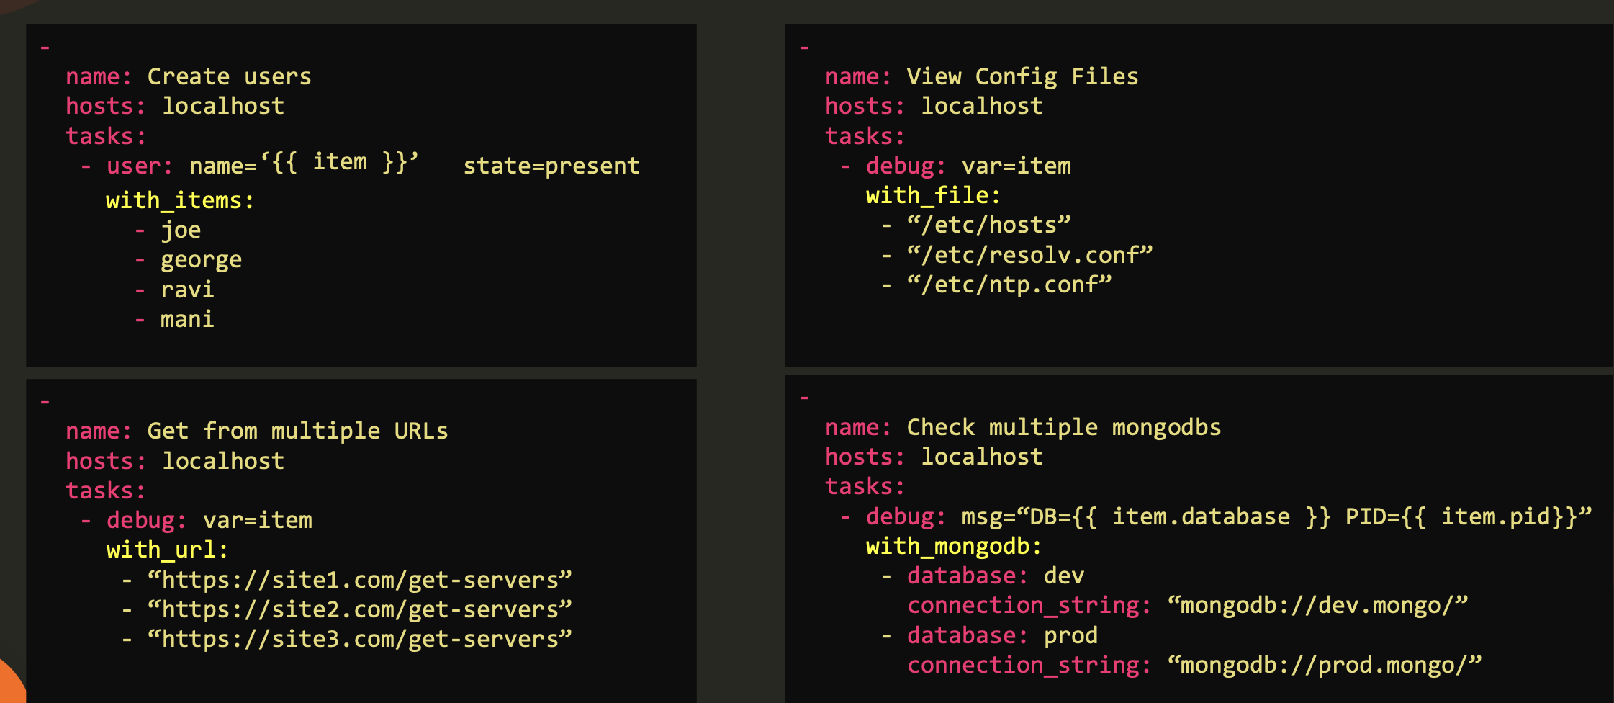
With_*

Slide 12
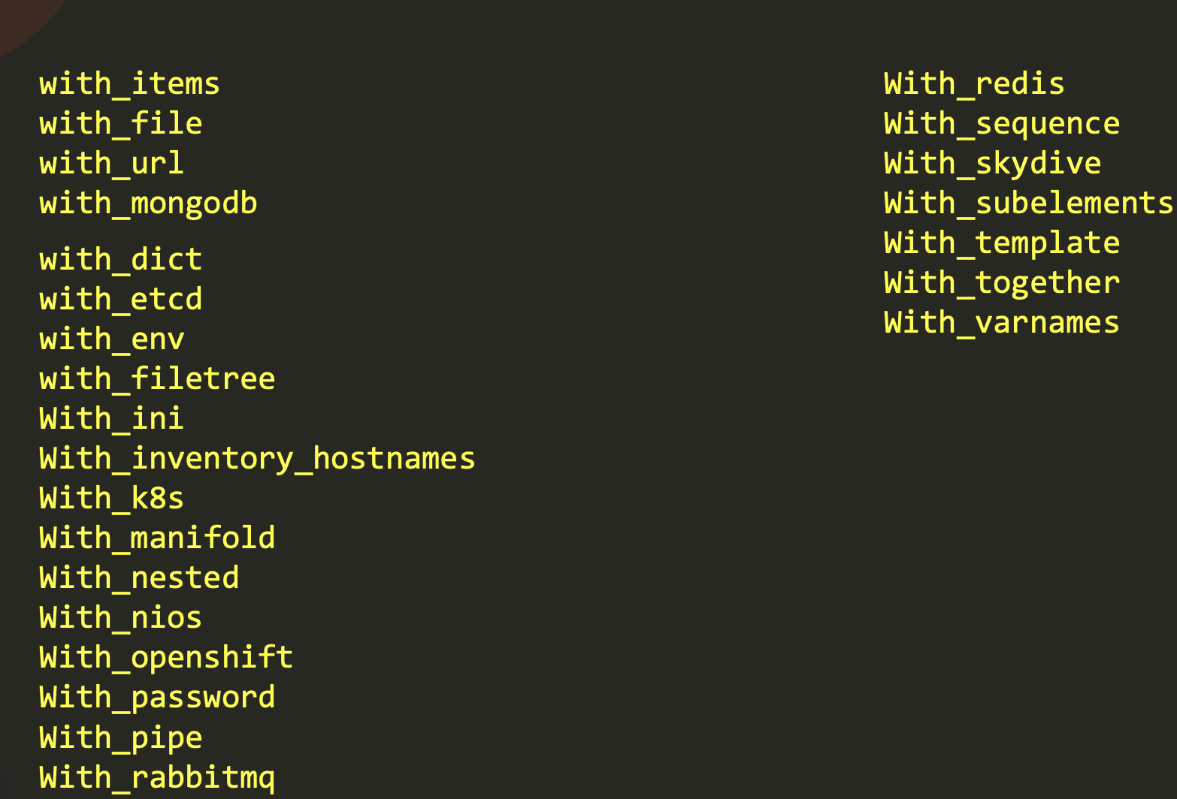
With_*

Slide 13
Plugins
Plugins are pieces of code that augment Ansible’s core functionality.
Ansible uses a plugin architecture to enable a rich, flexible and expandable feature set.
Ansible ships with a number of handy plugins, and you can easily write your own.
Action Plugins
Become Plugins
Cache Plugins
Callback Plugins
Cliconf Plugins
Connection Plugins
Httpapi Plugins
Inventory Plugins
Lookup Plugins
Netconf Plugins
Shell Plugins
Strategy Plugins
Vars Plugins
Filters
Tests

Slide 14
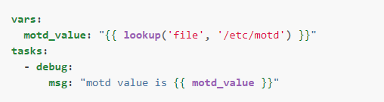

Modules & Plugins
If you are looking to add local functionality to Ansible, you might wonder whether you need a module or a plugin.
Here is a quick overview to help you decide between the two:
Modules are reusable, standalone scripts that can be used by the Ansible API, the ansible command, or the ansible-playbook command. Modules provide a defined interface.
Each module accepts arguments and returns information to Ansible by printing a JSON string to stdout before exiting. Modules execute on the target system (usually that means on a remote system) in separate processes.
    Plugins augment Ansible’s core functionality and execute on the control node within the /usr/bin/ansible process.
Plugins offer options and extensions for the core features of Ansible - transforming data, logging output, connecting to inventory, and more.
Example : Lookup Plugin
Example : Filter Plugin
https://docs.ansible.com/ansible/latest/plugins/lookup.html#lookup-plugins
https://docs.ansible.com/ansible/latest/plugins/filter.html

Slide 15
Install Tomcat server on VM - playbook
Install JVM and Tomcat on VM : Manual steps
https://www.digitalocean.com/community/tutorials/install-tomcat-on-linux
sudo apt update
sudo apt install default-jdk
java --version
sudo useradd -r -m -U -d /opt/tomcat -s /bin/false tomcat
wget -c https://downloads.apache.org/tomcat/tomcat-9/v9.0.72//bin/apache-tomcat-9.0.72.tar.gz
cp apache-tomcat-9.0.72.tar.gz /opt/tomcat/
cd /opt/tomcat
tar -xvf apache-tomcat-9.0.72.tar.gz
sudo chown -R tomcat: /opt/tomcat/*
cd bin
./startup.sh
sudo ufw allow 8080/tcp
open browser – enter <IP-Address>:8080

Slide 16
https://github.com/IBT-learning/ansible-playbooks/blob/tomcat/tomcat.yaml

Slide 17
Handlers
Sometimes you want a task to run only when a change is made on a machine.
For example, you may want to restart a service if a task updates the configuration of that service, but not if the configuration is unchanged.
Ansible uses handlers to address this use case.
Handlers are tasks that only run when notified.
Notifying handlers
Tasks can instruct one or more handlers to execute using the notify keyword.
The notify keyword can be applied to a task and accepts a list of handler names that are notified on a task change.
Alternately, a string containing a single handler name can be supplied as well. The following example demonstrates how multiple handlers can be notified by a single task.
Naming handlers
Handlers must be named in order for tasks to be able to notify them using the notify keyword.

